Slide 1
FINLAND UNIVERSITY
Visit in Vietnam
w. 38/2016

Slide 2

“Study where you can hear yourself think”

Slide 3

“Study where you can hear yourself think”

Slide 4
FINLAND UNIVERSITY
AGENDA
Finland – your best study destination
  Top 5 reasons to study in Finland
Study at Finland University
  Member universities in Tampere, Turku and Eastern Finland
  Areas of study
Scholarships to Vietnamese students
Q & A

Slide 5
What is Finland University?
University of Turku
Governments & ministries
Finland University is a joint effort of three top-level multidisciplinary Finnish research universities, the University of Turku, the University of Tampere and the University of Eastern Finland
We offer world-class Master Degree Programmes also for international students
Additionally Finland University offers customized educational solutions based on world-class scientific research
Educational experts
University of Eastern Finland
Potential students
Partners
University of Tampere
Educational leaders & decision makers

Slide 6

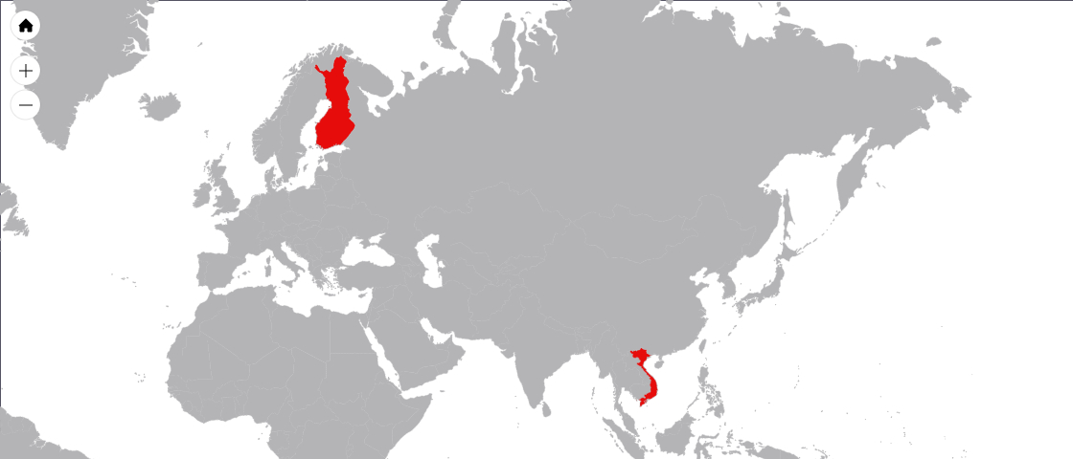


Finland in a nutshell
10h flight
Finland is independent democracy (has been since 1917) and is a core member of the European Union. There are 5,5 million of us about 10 hour flight away from Vietnam.
Its’s easy to find space for yourself in Finland as we have only 18.1 inhabitants per km² Additionally around 65 per cent of Finland’s total land area is covered in forest and we have almost 200 000 lakes. You really can hear yourself think in here!
On the other hand we rank first in digitalization (Digibarometer 2016) and have continuously succeeded in PISA rankings – being 6th in 2012. Everyone is treated equally: for example we ranked in top three in Global Gender Gap Index 2016!
It’s not a wonder why Finland has the highest quality of life in the world (Social Progress Index 2016)
Notes:
Images by: jukal / www.flickr.com
License: Creative Commons License ()

Slide 7
Finland in a nutshell
10h flight
Finland is independent democracy (has been since 1917) and is a core member of the European Union. There are 5,5 million of us about 10 hour flight away from Vietnam.
Its’s easy to find space for yourself in Finland as we have only 18.1 inhabitants per km² Additionally around 65 per cent of Finland’s total land area is covered in forest and we have almost 200,000 lakes. You really can hear yourself think in here!
On the other hand we rank first in digitalization (Digibarometer 2016) and have continuously succeeded in PISA rankings – being 6th in 2012. Everyone is treated equally: for example we ranked in top three in Global Gender Gap Index 2016!
It’s not a wonder why Finland has the highest quality of life in the world (Social Progress Index 2016)
Notes:
Images by: jukal / www.flickr.com
License: Creative Commons License ()

Slide 8
Top 5 reasons to study in Finland
#1 and #2 student satisfaction of international students in the world in 2015 & 2014
(International Student Satisfaction Awards by StudyPortals)
Highest quality of life in the world
(“Social Progress Index 2016” by Social Progress Imperative)
The most stable country in the world
(Fragile States Index report 2016 by Fund For Peace)
#2 least corrupted country in the world
(Corruption Perceptions Index (2015) by Transparency International)
#5 in fluency of English (from countries without English mother tongue)
(EF EPI, English Proficiency Index 2015)
References for the proof points marked in grey

Slide 9



Study at Finland University
50,000
2%
students
among top globally
800
60
professors
Master´s degree programs
+7,000
100+
peer reviewed articles
supporting subjects
Finland University with its member universities form the largest university in
the Nordics with appr. 50,000 students, 800 professors and +7,000 peer reviewed articles
All Finland University member universities among top 2% globally
60 MDP´s and choose supporting subjects from over 100 options
Finland University is a joint marketing company of three top-level multidisciplinary Finnish research universities

Slide 10
Finland University – Member universities
All universities are multidisciplinary and offer Master’s degrees for international students in several different areas with over 100 different minor subject options
Campuses located in Joensuu, Kuopio and Savonlinna.
Ranked in top 400 universities globally (Times Higher Education Ranking 2015)
One of the largest universities in Finland with approximately 15,000 students and
2,800 staff members, many with international background
Known especially for its interdisciplinary, strong research that seeks to find solutions
to global challenges affecting individuals and societies
Located in Tampere – Finland’s third most populous city
Ranked in top 350 universities globally (Times Higher Education Ranking 2015)
Approximately 7 % of UTA’s 14,000 students, and over 6 % of UTA’s almost
2,000 strong staff have international backgrounds
Known especially for its research on the society and health
Located in Turku – Finland’s sixth most populous city
Ranked in top 400 universities globally (Times Higher Education Ranking 2015)
Offers a place to study for almost 20,000 students – supported by over 3,000 staff members
Second largest university in Finland by student enrolment
The most international university in Finland (Times Higher Education Ranking 2016)

Slide 11
Top 5 reasons to study at Finland University
Finland University member universities form the largest university in the Nordics with appr. 50,000 students, 800 professors and +7,000 peer reviewed articles
All Finland University member universities among top 2% globally
All Finland University member universities are multidisciplinary research universities
60 major subject + choose minor subjects from over 100 options
Tutoring, personal study planning, study guidance & counseling included in the tuition fee
References for the proof points marked in grey

Slide 12

Areas of study
Social sciences
Data science
Business & management
Medicine & pharma
Natural sciences
Education
Law
Language studies

Slide 13
Areas of study - example of programmes
Social sciences
Data science
Border Crossings, Global and Local Societies in Transition, Master of Social Sciences
Media Education (M.Soc.Sc)
Gender Studies
Global and Transnational Sociology
Peace, Mediation and Conflict Research
Public Choice
Baltic Sea Region Studies
European Heritage, Digital Media and the Information Society
Pathway in Popular Culture Studies
East Asian Studies
Information Technology
Computational Big Data Analytics
Human-Technology Interaction
Internet and Game Studies
Software Development
Embedded Computing
Information Security and Cryptography
Information Technology for Enterprise Management, ITEM, dual degree option

Slide 14
Areas of study - example of programmes
Medicine & pharma
Business & management
Biomedicine
General Toxicology and Environmental Health Risk Assessment
Public and Global Health
Biomedical Technology
Molecular Biotechnology and Diagnostics
Digital Health and Life Sciences
Biomedical Imaging
Drug Discovery and Development
Innovation Management
International Business and Sales Management
Tourism Marketing and Management
Leadership for Change (Governance for Sustainable Change)
Leadership for Change (Sustainable Business Management)
Innovative Governance and Public Management
Leadership for Change (Politics in Wider Europe)
Management of Information Technology
Futures Studies

Slide 15
Areas of study - example of programmes
Natural sciences
Education
Photonics
Research Chemists
Wood Materials Science
European Forestry
Forestry (CBU)
Astronomy and Space Physics
Food Development
Materials Science
Photonics and Industry
Photonics in Informatics and Media technology
Early Language Education for Intercultural Communication,
Learning, Teaching and Counselling in Intercultural Context
Media Education (MA)
Teacher Education
Learning, Learning Environments and Educational Systems

Slide 16
Areas of study - example of programmes
Law
Language studies
Environmental Policy and Law
International Economic and Resources Law
Law and Information Society
English Language and Culture
Linguistic Sciences
Clinical Linguistics
Finnish and Other Finno-Ugric Languages

Slide 17
Scholarships to Vietnamese students
Member universities of Finland University offer generous scholarships
More information on scholarships on the following sites:
  http://www.uef.fi/web/admissions
  http://www.uta.fi/admissions/
  https://www.utu.fi/en/units/ffrc/studying/FutureMasters/admission/Pages/home.aspx

Slide 18
Tuition fees to Vietnamese students
At the University of Eastern Finland, degree programmes will charge fees of 8,000 to 15,000 euro for one academic year. Two-year Master’s degree programme students can apply for scholarships at the same time as they apply for the degree programme. There are two scholarships available for international students.
Tuition fees will be charged from non-EU/EEA students from the autumn 2017 onwards, and the tuition fees range between 8,000 and 20,000 euros, depending on the programme. For non-EU/EEA students required to pay tuition, the University of Eastern Finland offers an attractive and generous scholarship scheme: in the university’s strategically important programmes scholarships are available to 75% of non-EU/EEA students. This scholarship covers the tuition fee either in full (100%), or partially (80%). In all other programmes, scholarships are available to 50% of non-EU/EEA students (100% and 80% of the tuition fee).
In order to qualify for the second year of a scholarship, student must earn at least 55 credits per semester.

Slide 19
Tuition fees & Scholarships
Tuition fee: 8 000 to 20 000 euro per academic year, tuition program specific
Scholarships. For non-EU/EEA students UEF offers attractive and generous scholarships:
  For strategic programmes scholarships are available to 75% of non-EU/EEA students.
  In all other programmes, scholarships are available to 50% of non-EU/EEA students
  Scholarship covers the tuition fee either in full (100%) or in part (80%).
  To qualify for the second year of a scholarship, student must have earned at least 55 study credits (full degree 120 study credits)

Slide 20
Tuition fees to Vietnamese students
At the University of Tampere, degree programmes will charge fees of 8,000 to 12,000 euro for one academic year. Two-year Master’s degree programme students can apply for scholarships at the same time as they apply for the degree programme. There are two scholarships available for international students.
The University of Tampere tuition fee scholarship covers 50 or 100 per cent of the tuition fees in a two-year Master’s degree programme.
The University of Tampere global student award for academic excellence scholarships cover the whole tuition fee and includes a 7,000-euro scholarship to cover student’s living expenses. In order to qualify for the second year of a scholarship, student must earn at least 55 credits per semester.

Slide 21
Tuition fees & Scholarships
Tuition fee: 8 000 to 12 000 euro per academic year, program specific
Scholarships available to non- EU/EEA students
  cover 50 or 100 per cent of the tuition fees
  The University of Tampere global student award for academic excellence scholarships cover the full tuition fee plus a Euro 7 000 scholarship for living expenses.
  To qualify for the second year of a scholarship, student must have earned at least 55 study credits (full degree 120 study credits)

Slide 22
Tuition fees to Vietnamese students
At the University of Turku, degree programmes will charge fees of 8,000 to 15,000 euro for one academic year. Two-year Master’s degree programme students can apply for scholarships at the same time as they apply for the degree programme. There are two scholarships available for international students.
The University of Turku scholarship programme offers scholarships covering either a part of the tuition fee or the entire tuition fee. You can apply for a scholarship at the same time as applying for admission to one of our Master’s Degree Programmes. For students who were not granted a scholarship, but have succeeded very well in their studies during their first year at the University of Turku, there is the possibility to apply for a second year scholarship. In order to qualify for the second year of a scholarship, student must earn at least 55 credits per semester.

Slide 23
Tuition fees & Scholarships
Tuition fee: 8 000 to 15 000 euro per academic year.
Scholarships available to non-EU/EEA students
  cover part or full tuition fee.
  To qualify for the second year of a scholarship, student must have earned at least 55 study credits (full degree 120 study credits)
  NB! Students who were initially not granted scholarship but have excelled in their studies during their first year are eligible to apply for a second year scholarship.

Slide 24
How and when to apply?
Application period: 1 December 2016 to 13 January 2017
Find out more about studying in Finland: http://www.studyinfinland.fi/
More on Finland http://www.visitfinland.fi
Visa applications http://www.migri.fi/studying_in_finland
References for the proof points marked in grey

Slide 25
After enrollment you have access to
Wireless Internet access on campus, computer classes available 24/7
Free us of library resources
Discounts on local buses and long-distance transportation
Discounts on many public services and free-time activities
Discount price lunches at student cafeterias
Free basic health care

Slide 26
More information at www.finlanduniversity.fi

Slide 27
“Study where you can hear yourself think”

